Slide 1
Ready Online!
By Aditi Roy 1901011, Anushree Anil 1901039, Aparna Raj 1901040, Jishu Yadav 1901082

Slide 2
Introduction
This project creates an online market for Sellers and Buyers and all people who wish to market products online in general. It will have a range of features from purchasing items online, adding to your cart, making payments online. The App will have better navigation features such that you can jump from home page to profile page just by a small voice note as: “Go to profile”.

Slide 3
Contribution
Aditi Roy (1901011)
Backend
SRS Document,Data Flow Diagram and Use Case Diagram
Testing Report and Presentation
Anushree Anil (1901039)
Frontend
SRS Document,Data Flow Diagram and Use Case Diagram
Testing Report and Presentation
Aparna Raj (1901040)
Frontend
SRS Document,Data Flow Diagram and Use Case Diagram
Testing Report and Presentation
Jishu Yadav (1901082)
Backend
SRS Document,Data Flow Diagram and Use Case Diagram
Testing Report and Presentation

Slide 4
Functional Requirements

Slide 5
Users

Slide 6
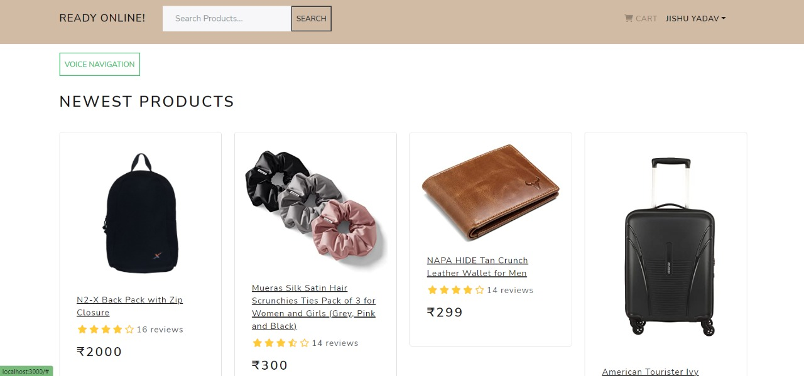
All the products will be listed to be viewed in the form of cards displaying the picture, price, short description.

Slide 7
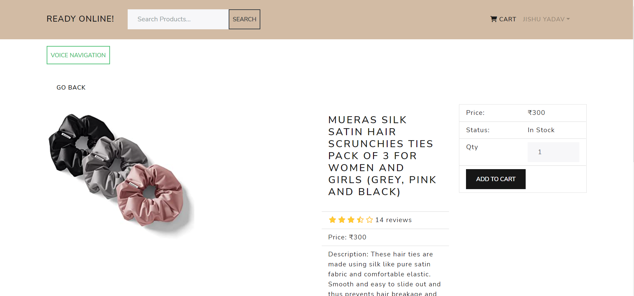
A detailed information of the product can be seen after clicking on it.

Slide 8
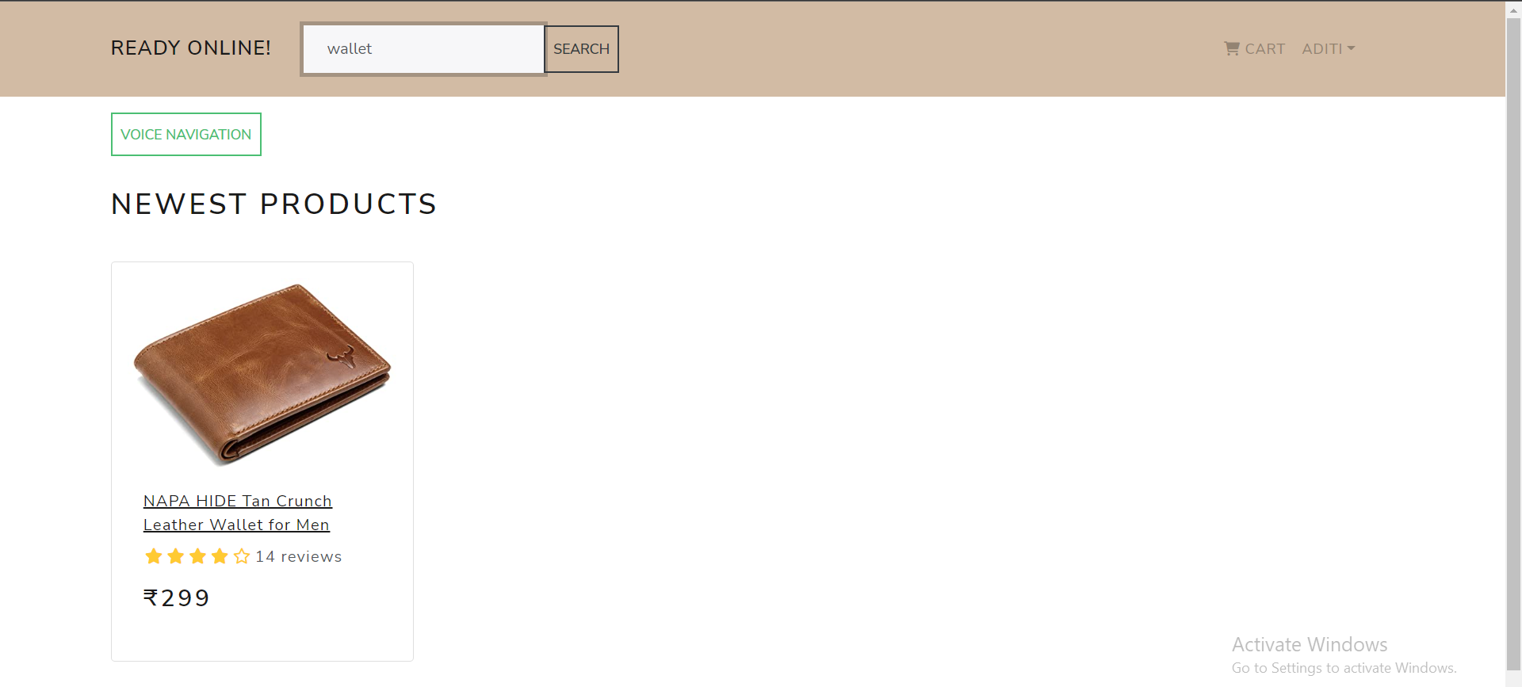
Users will be able to search for products via the search bar.
We have put a search bar on the home page where users can search for products using a keyword, and the results will be displayed.

Slide 9
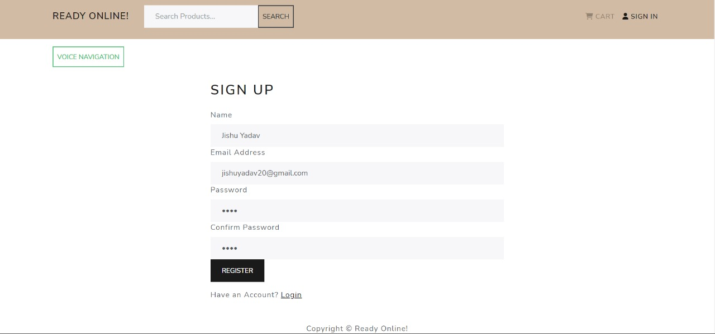
Users must provide name, registered email address and password during the sign-up process.

Slide 10
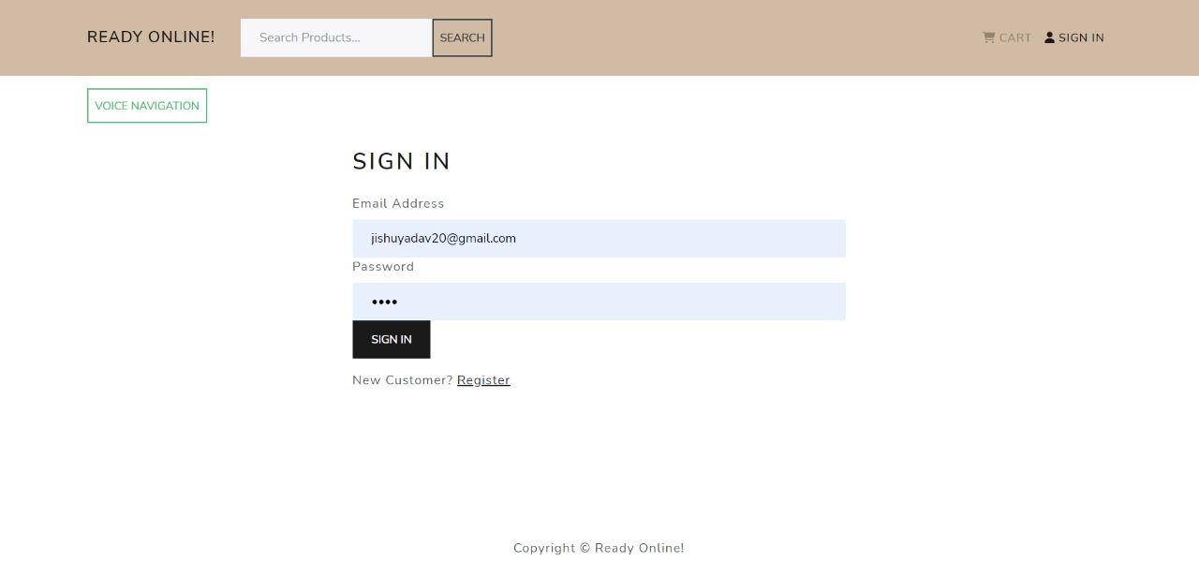
Users will be able to sign in to their account using email address and password .

Slide 11
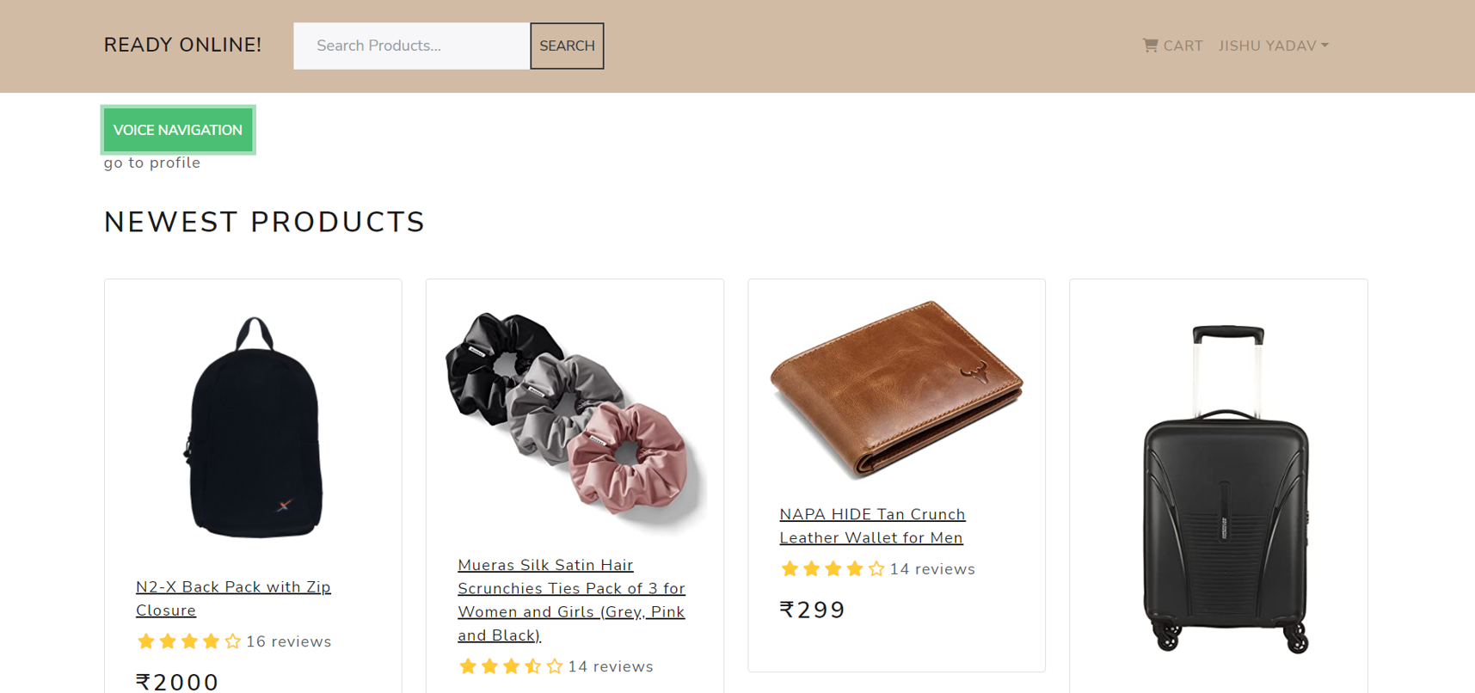
Users will be able to navigate to different pages via voice.

Slide 12
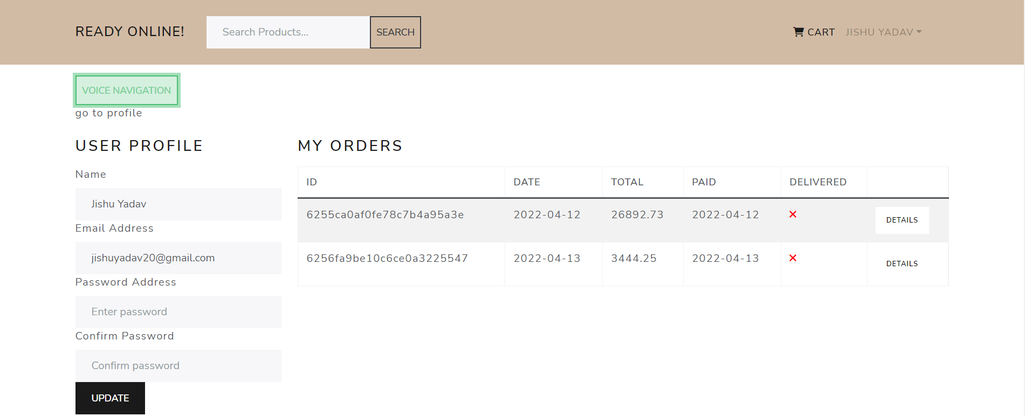

Slide 13
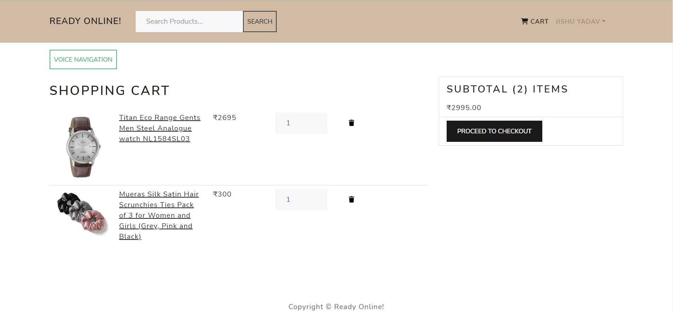
Users can see the added products in the cart after clicking on the cart icon.

Slide 14
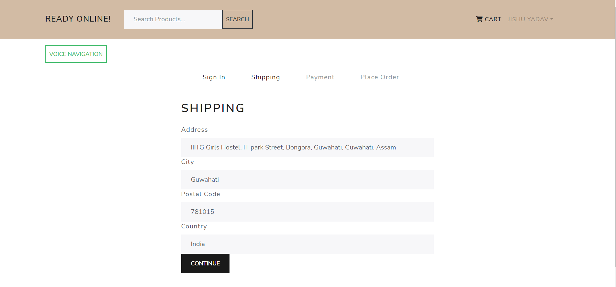
After that, users can place order and make payment.

Slide 15
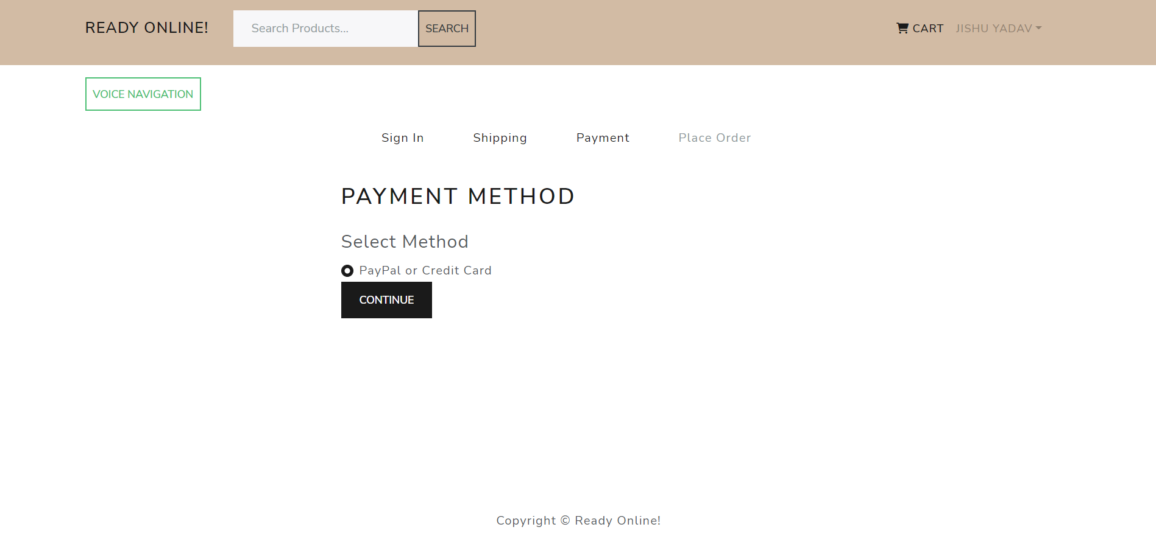

Slide 16
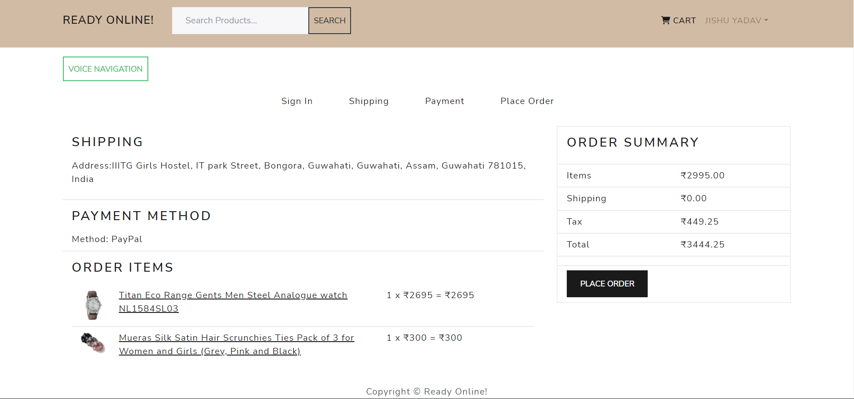

Slide 17
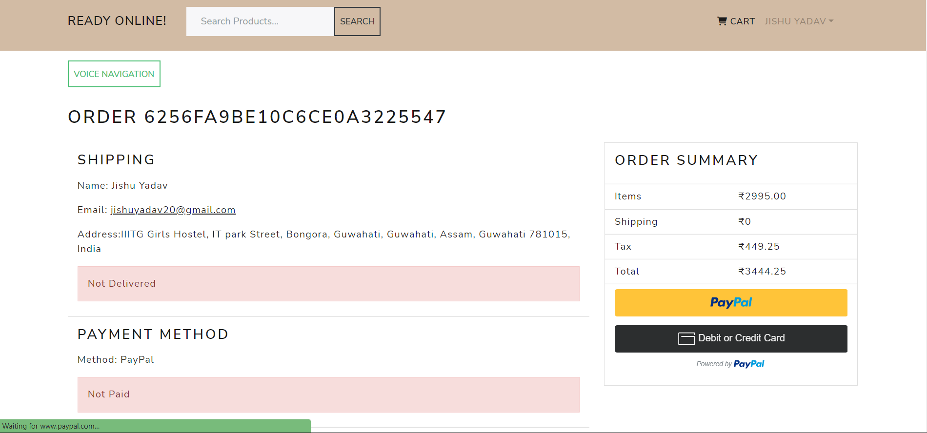

Slide 18
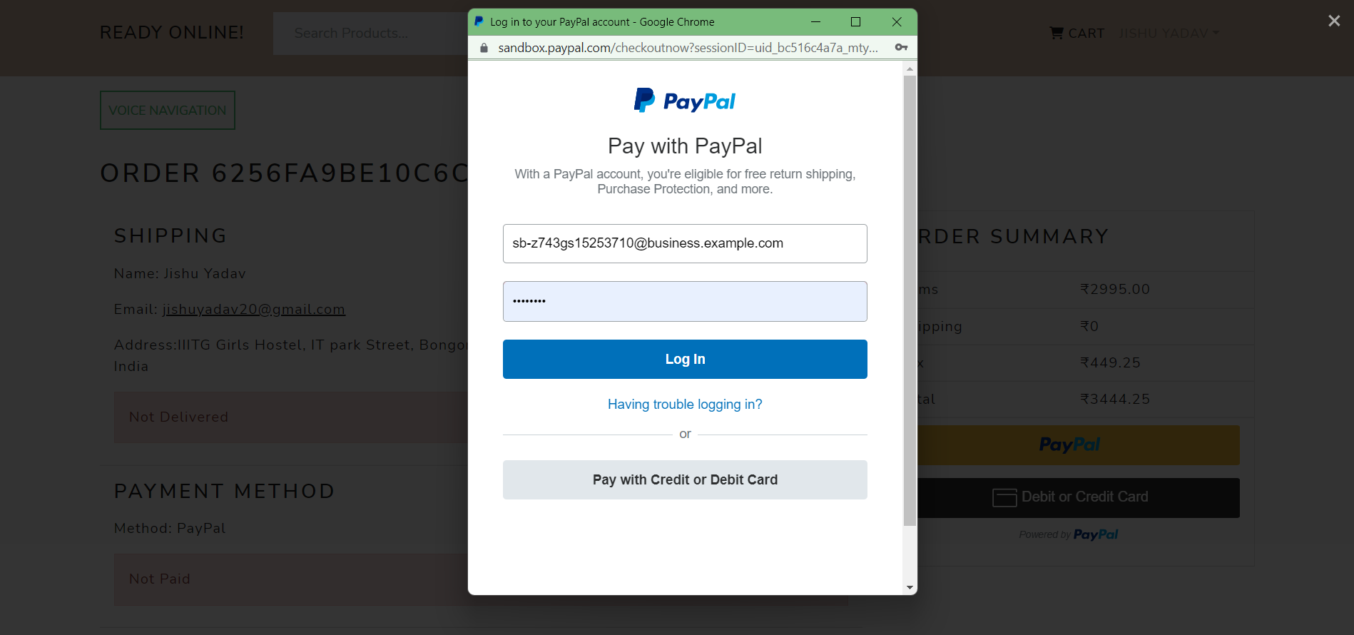
Buyers can make their payment using cash on delivery or UPI(PayPal).

Slide 19
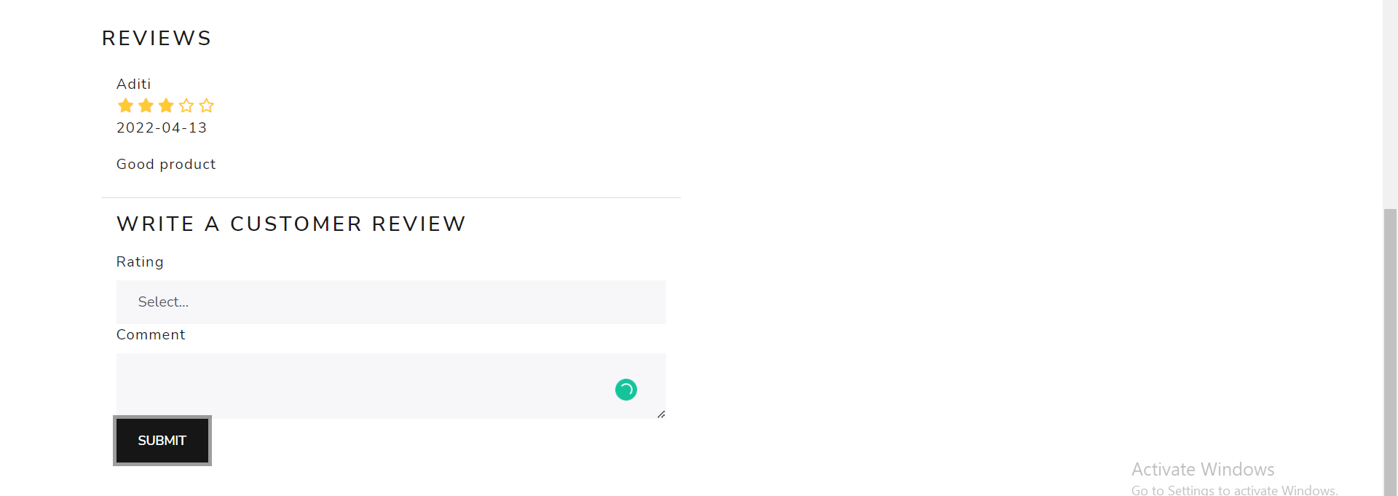
Buyers can write a review about the product.

Slide 20
Admin

Slide 21
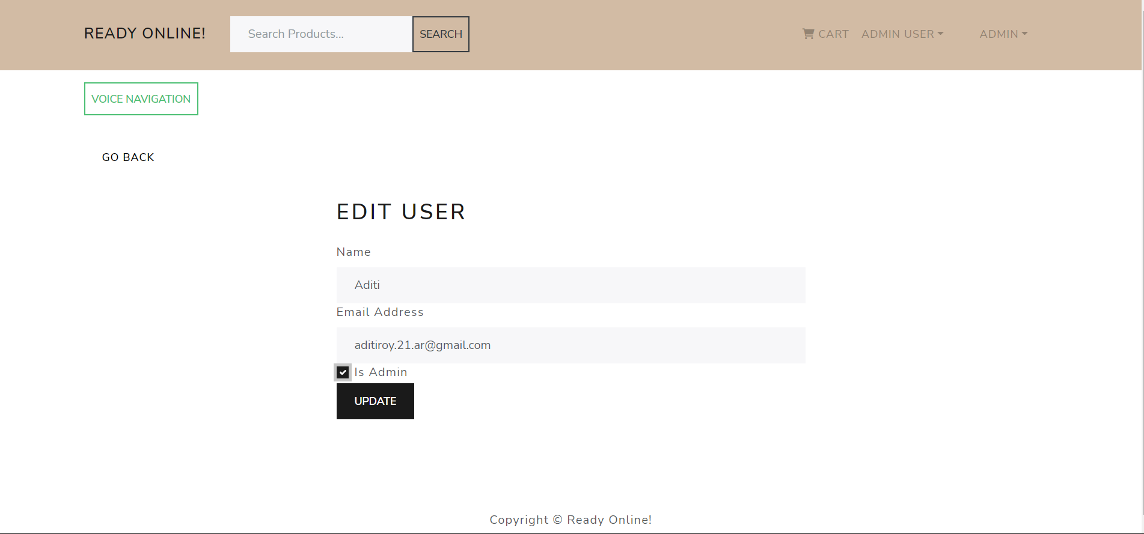
Admin can make users admin.

Slide 22
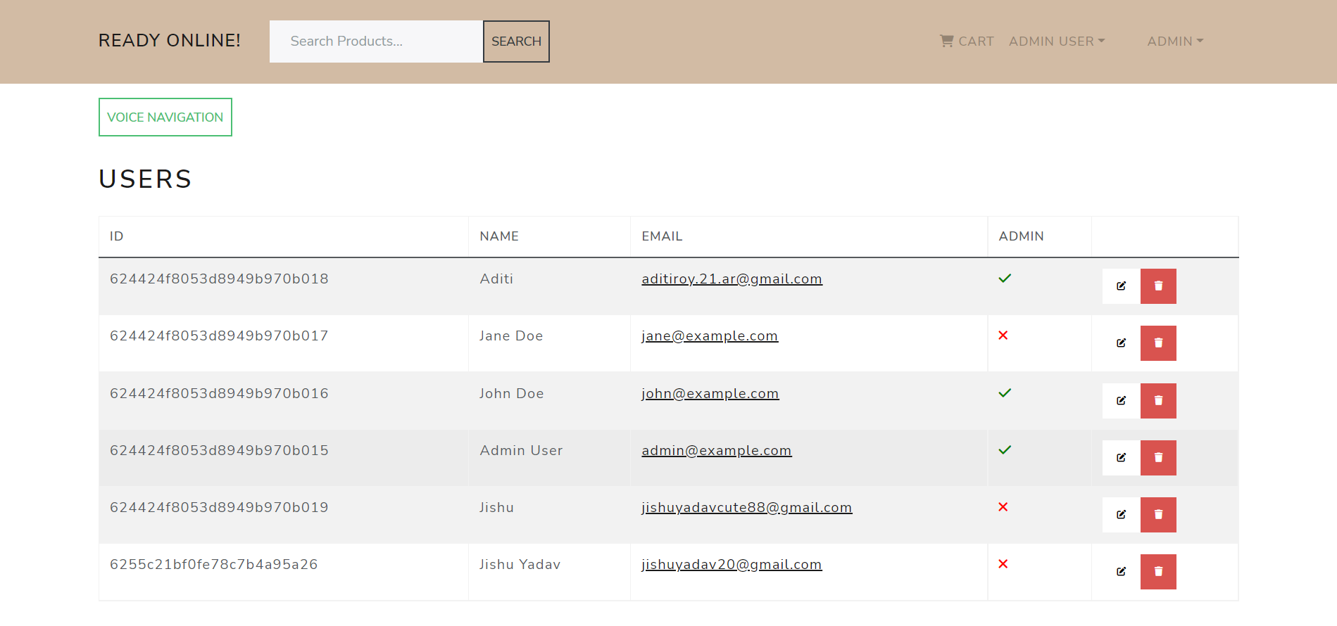

Slide 23
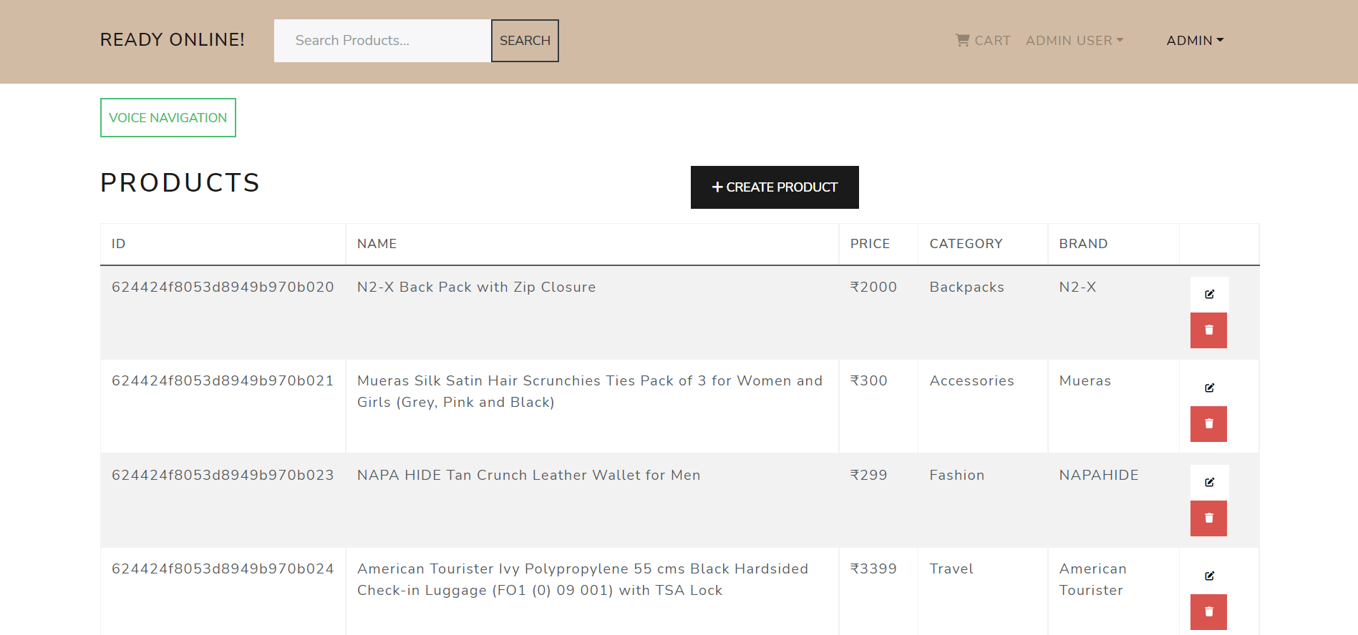
Admin can edit products.

Slide 24
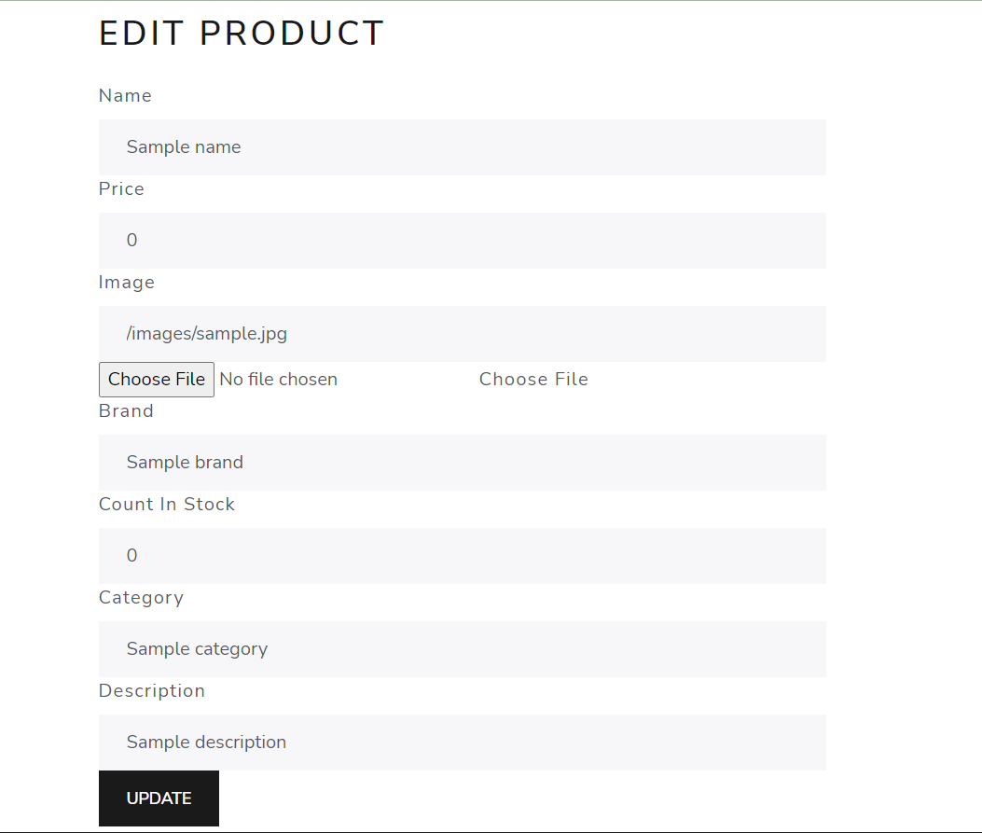

Slide 25
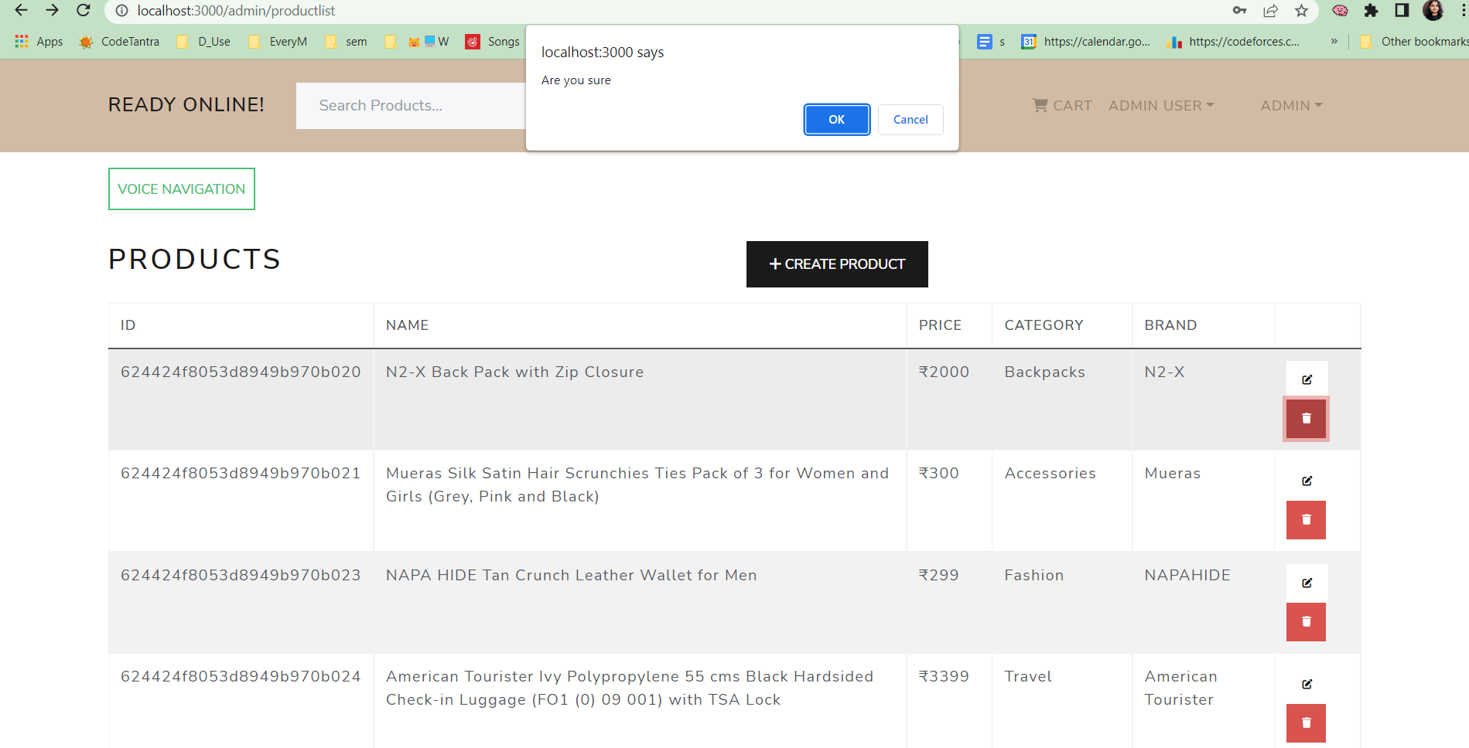
Admin can delete products.

Slide 26
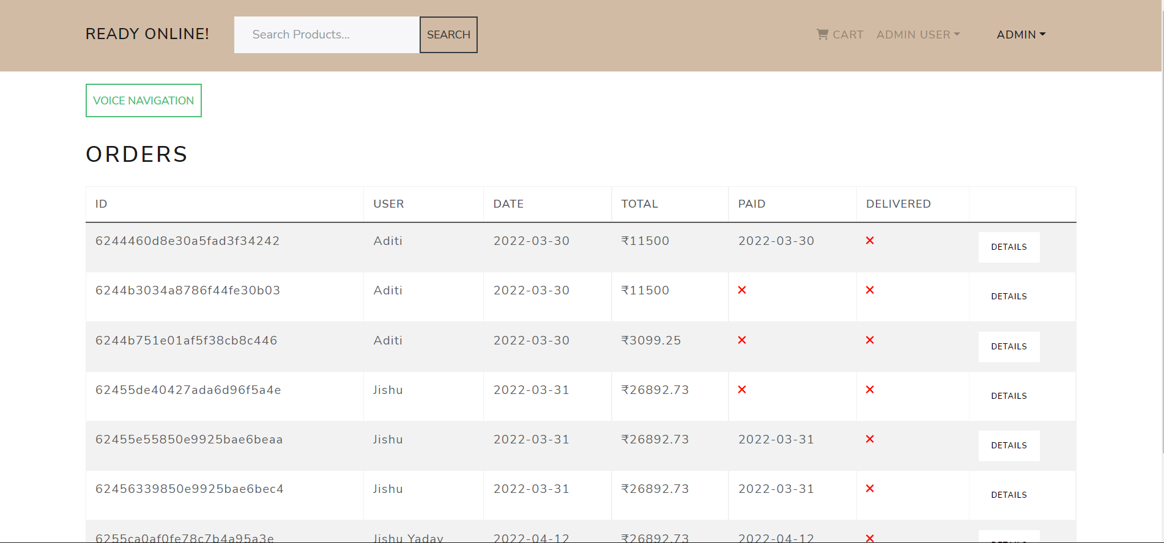
Admin can manage users’ orders.

Slide 27
THANK YOU!

